Slide 1




Clickbait Detection using MobileBERT and BiGRU for Filipino News Headlines
Group Members:
Ang, Matthew Szenel S.
Abid, James Paul N.
Tan, Andre Deuce B.
BS in Computer Science
Adviser:
Jeanie R. Delos Arcos

Slide 2



Background of the Study
Clickbait
Defined as article headline designed to entice users to engage with it to generate revenue through engagement with the site it is hosted on. (Mahtab et al., 2022).
The contents of the article are often dubious, often containing unverified or false information (Pengnate et al., 2021).
In 2017, it was reported that 39.96% of unreliable media make use of clickbait titles and comprise of 33.54% of all mainstream media (Pengnate et al, 2021)
Notes:
Despite how seemingly harmless this practice is, it may present significant real world consequences when done irresponsibly.
Many of the ads promoted by these sites often endorse scams and malware, which the hosting website will often overlook due to potential revenue and an overall higher clickthrough rate than traditional display ads.
However the most damage done by clickbait trends to journalism is to credibility caused by misinformation.

Slide 3

Background of the Study (cont.)
72.5% of the total population in the Philippines uses social media.
Furthermore, 49.5% of the total population, roughly half of the total population in the Philippines, is reported to use the video sharing social media platform known as YouTube (Kemp, 2023).
YouTube does not have clear policies against misinformation.
Many channels which post these clickbait videos often have high upload and subscriber counts, which may reinforce a false image of credibility to viewers (Tuquero, 2021).
Other countries such as the Philippines would more often see clickbait relating to politics (Newman, 2022).
Notes:
Moreover, the videos uploaded by these channels often contain titles which may be classified as clickbait, often containing provocative and sensationalized titles or thumbnails which may present false narratives

Slide 4



Background of the Study (cont.)
Examples of Clickbait
Notes:
In 2021, an article published by Forbes had a misleading headline that claimed that the COVID-19 vaccine altered a person’s DNA, which inaccurately described the process that the article itself was referring to.
The headline was changed after criticism, however the damage had been done and the original headline had been widely spread around social media, igniting more conspiracy theories and further misinformation regarding the topic of the vaccine (Teoh, 2021)
Other countries would report misleading articles more related to politics, such as the Philippines (Newman, 2022), one such news claiming that martial law had been declared after a Chinese water cannon attack at the Philippine Coast Guard. The clips showcased by the video would then later clarify that the one of the senators had merely suggested the imposition of martial law to which no other senator explicitly supported (VERA Files, 2023).
Another example is a video that attempts to pass off a South African Frigate as a warship gift from Russia and claims that Russian President Vladimir Putin had gave the Philippines the "brand new warship" without payment.
However, the country has had no warship supply agreement with Russia, and Russia had not been reported to have sent any vessels to the Philippines.
It should be noted that this video came out three days after Russian news agency TASS reported that Russia aims to simplify visa procedures in six countries including the Philippines and that the Philippines was also among the 141 countries in the United Nations that voted to demand Russia’s withdrawal from Ukraine around the same time.

Slide 5


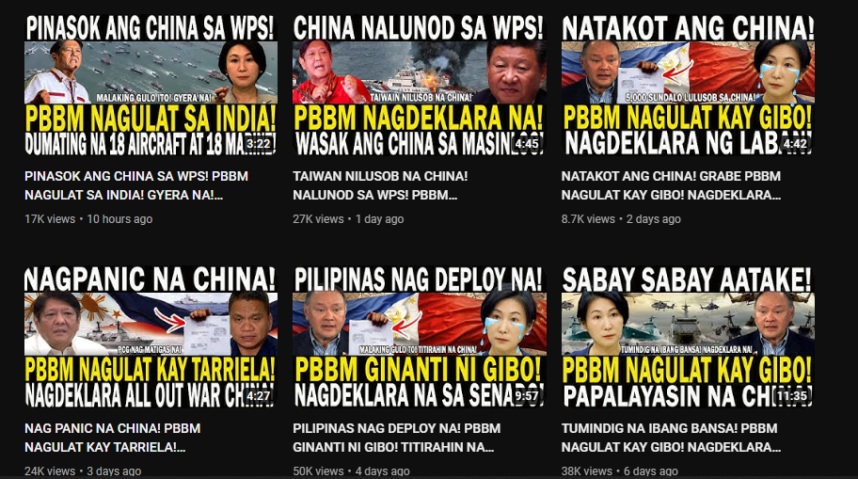
Background of the Study (cont.)
Notes:
One such example, the video titled "China has already captured Ilocos! President Bongbong Marcos warned China! This is war! Sudden announcement of the president)!”
This video falsely claims that China has invaded the Ilocos Region of the Philippines but does not substantiate its claims. Furthermore, the video plays military footage which has been confirmed by fact checking organization VeraFiles to be clips of the Armed Forces of the Philippines’ military exercises and is unrelated to any military operations in the Ilocos Region involving the Chinese
This video alone has over 39,000 views with many similar such videos regularly uploaded.

Slide 6

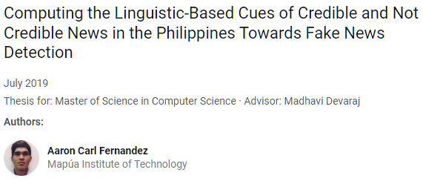
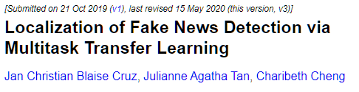
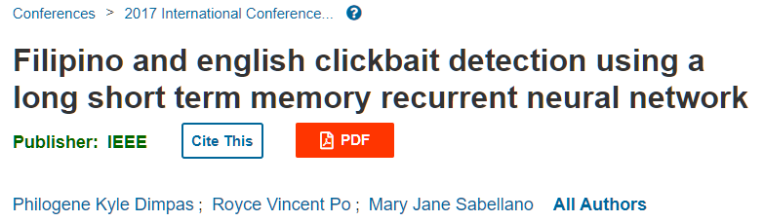
Statement of the Problem
Serial tabloidization and sensationalized headlines have pervaded online journalism which has caused cases of misinformation and rumors of false news to be spread around the internet, notably around social media networks.
There have been a total of only three (3) papers on clickbait detection model in the Philippines; last research on the topic dates to 2019.
Notes:
Not only can such misinformation have real world consequences, especially regarding topics such as the COVID-19 pandemic or national politics, these articles may also harm individual users via promoting untrustworthy advertisements promoting scams or malware.

Slide 7

Research Objectives — General Objectives
General Objectives
To develop a clickbait detection system for Filipino news headlines.

Slide 8


Research Objectives — Specific Objectives
Evaluate Model
Evaluate the performance of the clickbait detection model.
Generate Dataset
Collect clickbait and non-clickbait Filipino News Headlines (both in Filipino and English).
Train Model
Develop a clickbait detection system using a pre-trained MobileBERT language model with a BiGRU model.

Slide 9

Research Objectives — Specific Objectives (cont.)
Develop a Web Application
Develop a web application to interact with the clickbait detection model.

Slide 10
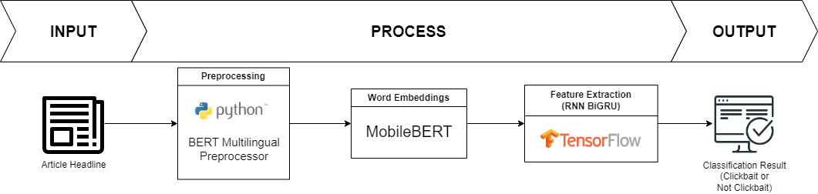
Conceptual Framework

Slide 11
Related Literature — Clickbait Detection
 | (Klarith, 2018) | (Daoud et al., 2019) | (Gothankar et al., 2021) | (Mahtab et al., 2022)
Language | Thai | English | English | Bengali
Methods | FNN BiLSTM BiGRU | Logistic Regression SVM | Using Word2Vec Logistic Regression Random Forest Multilayer Perceptron (MLP) Using BERT MLP Using DistilBERT MLP | CNN BiLSTM BiGRU BERT ROBERTA DistilBERT
Objectives | Clickbait Detection (Headline) | Develop a clickbait detection model with minimum amount of features (24 features) | Clickbait Detection (YouTube videos) | Dataset Creation Clickbait Detection
Evaluation Metrics | Accuracy Precision Recall F1 Score ROC-AUC | Precision Recalll F1 Score | Precision Recall F1 Score Support | Accuracy Precision Recall F1 Score Loss

Slide 12
Related Literature — Philippines
 | (Dimpas et al., 2017) | (Cruz et al., 2019) | (Fernandez, 2019) | Ours
Language | Filipino & English | Filipino & some English words (commonly used in Filipino vernacular) | English | Filipino & English
Methods | BiLSTM | Siamese NN (w/ LSTM & ReLU) ULMFiT BERT GPT-2 Multitask Finetuning | Gaussian Naïve Bayes Logistic Regression SVM | MobileBERT + BiGRU
Objectives | Clickbait Detection (Headline) | Expertly Curated Dataset Creation (Fake News Filipino) Benchmark TL Methods for fake news detection | Dataset Creation (Philippine Fake News Corpus, Jan2019_data) Determine significant features for credible news detection Evaluate the impact of the identified features on ML methods for fake news detection | Dataset Creation Clickbait Detection (Headline)
Evaluation Metrics | Accuracy (Testing, Validation*) | Val. Accuracy Loss Val. Loss | Accuracy Precision Kappa | Accuracy Precision Recall F1 Score

Slide 13
Related Literature — BERT-BiGRU Model
 | (Li et al, 2023) | (Liu et al., 2019) | (Yu et al., 2021) | (Zhang et al., 2022) | (Maity et al., 2021)
Languages | Chinese | Chinese | Chinese | Chinese | English & Hindi
Task | Text Classification (Sentiment Analysis) | Knowledge Extraction | Text Classification | Text Classification (Sentiment Analysis) | Text Classification
Objectives | Detecting the sentiment of public opinion from posts in Sina Weibo. | Disease-drug relationship extraction. | Application of BERT-BiGRU model in the NLP task of Text Classification | Sentiment Analysis on e-commerce reviews. | Identifying hate speech, offensive and profane content from a social media post.
Notes:
Talk about how the BERT-BiGRU model has been used by several studies and how it was applied.

Slide 14



Methodology — Dataset Collection
Fact-Checking Organizations
Trusted News
Outlets
Notes:
Existing dataset is from 2019. Needs to be updated.
Philippines Fake News Corpus Dataset by Fernandez (English only)
Clickbait:
Vera Files – A non-profit fact-checking organization in the Philippines
National Union of Journalists in the Philippines (NUJP)
Non-clickbait:
Confirmed by Media Bias / Fact Check – American website known for rating the political bias, and factuality of news outlets globally with a methodology that has been openly shared.
Reputable News Outlets like The Philippine Star, Philippine Daily Inquirer, etc.
Our gathered dataset will have equal amounts of clickbait and non-clickbait headlines.

Slide 15


Methodology — Dataset Collection (Instrument)
Beautiful Soup
Selenium WebDriver
Notes:
Beautiful Soup
An open-source Python library used in extracting/parsing data from HTML and XML files.
Will be used to scrape the selected sites of their article headlines.
Selenium WebDriver, a web browser automation framework, was used to automate the actions of the web browser while scraping.
Also APIs

Slide 16



Methodology — Training & Deployment
Google Colaboratory
Vercel
Render

Slide 17
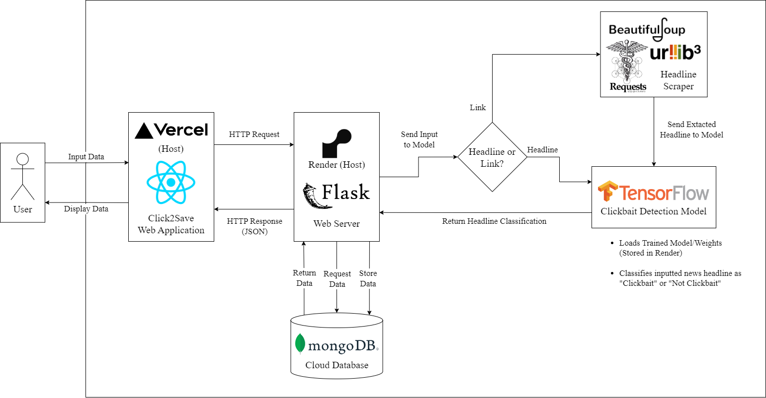
Methodology — System Architecture

Slide 18

Methodology — BERT (Language Model)
BERT (Bidirectional Encoder Representations from Transformers)
Introduced by Google in 2018 for use in Natural Language Processing.
Bidirectional – captures the context and information from both left and right sides for a word in a sentence.
Used in over 150 studies after its introduction (Rogers et al, 2020).
Used in Google’s search engine, Google Search (Nayak, 2019).

Slide 19
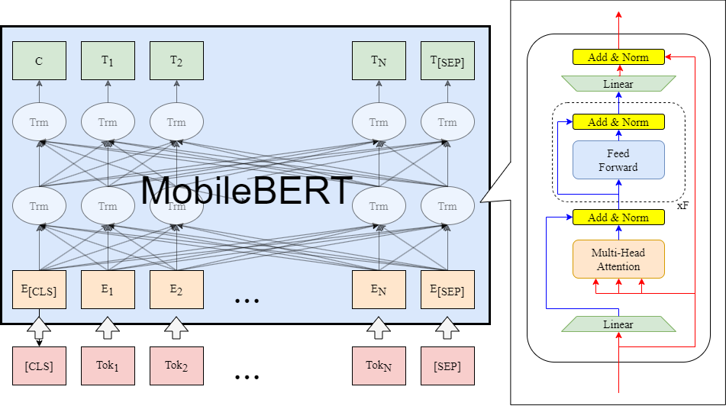
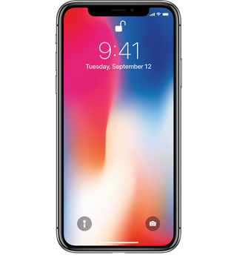
Methodology — MobileBERT (Language Model)
MobileBERT
More compact and faster version of BERT to be more easily deployed on mobile or more resource-limited devices.
Has similar performance to BERT_{BASE}, being 4.3x smaller and 5.5x faster.
Compared to DistilBERT (another compact BERT model), it is 2.64x smaller and 2.45x faster while outperforming the latter.
Notes:
- BERT used as Word Embeddings (similar to Word2Vec & GloVe)
- BERT takes advantage of punctuation and stopwords to further understand a sentence.

Slide 20
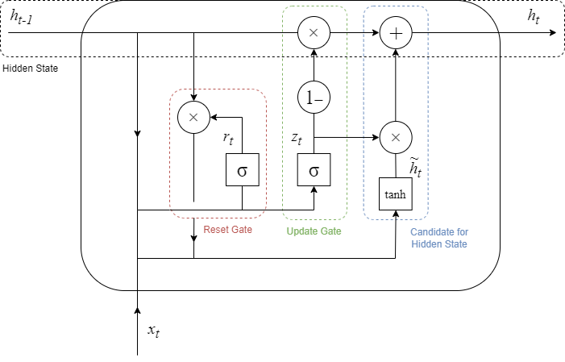
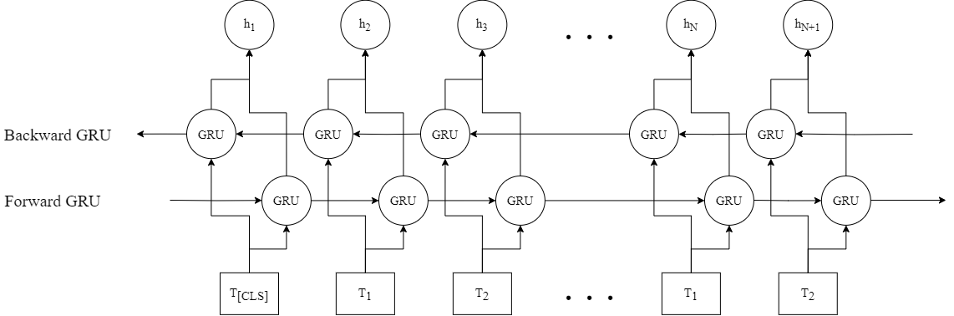
Methodology — BiGRU (Feature Extraction)
Bidirectional Gated Recurrent Unit (BiGRU)
RNNs are often used in NLP applications.
GRU is a type of RNN architecture that solves the problem of vanishing gradients in RNN.
Similar to LSTM, except simpler and less computationally expensive to implement. Has similar performance to LSTM.
Bidirectional.
Notes:
Examples of RNN Usage:
Virtual Assistants (Siri, Alexa, Google Assistant)
Speech Recognition
Language Translation
Predictive Text
Text Classification
Bidirectional
When analyzing the possible meaning of a word, only the words preceding the word are captured, and in this case, having the information of the succeeding words contributes to understanding the meaning of a word

Slide 21
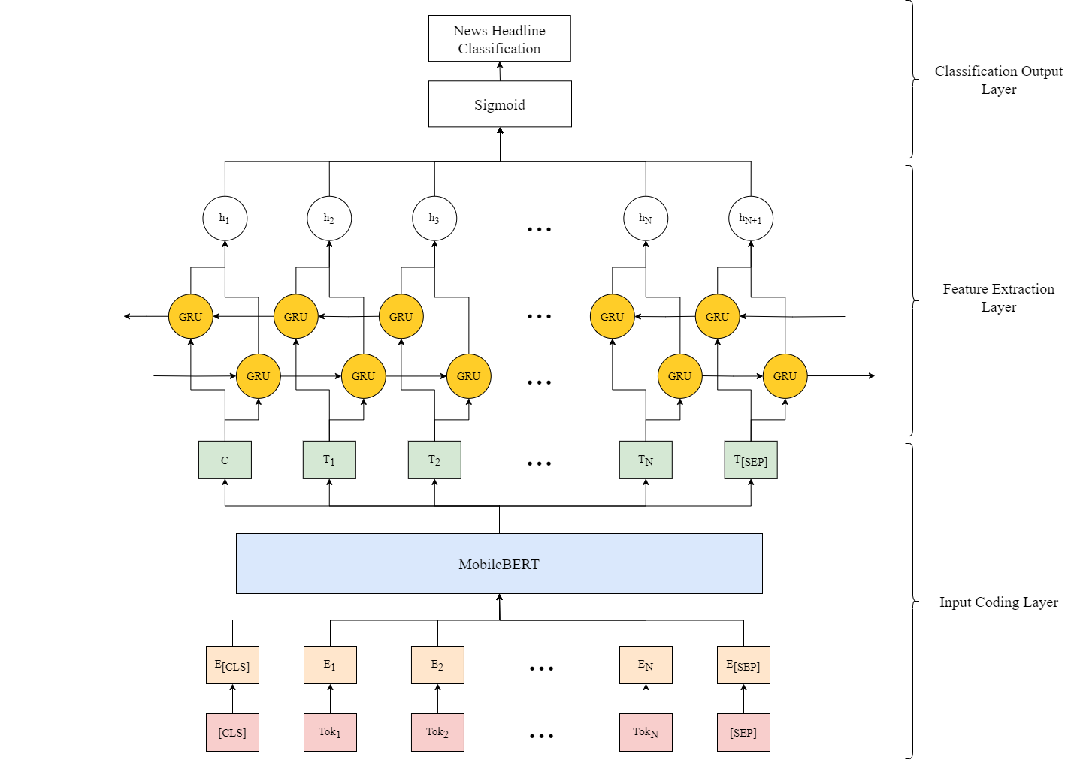
Methodology — Model Diagram

Slide 22
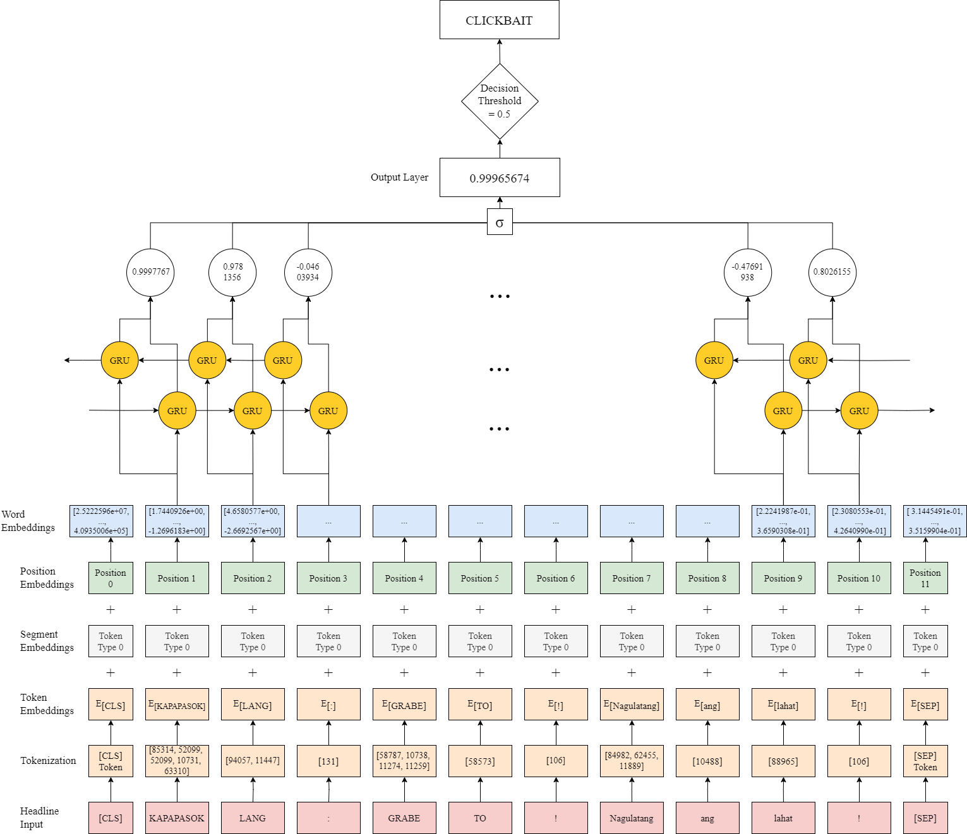
Methodology — Model Diagram (w/ Sample Input)
Notes:
Examples of RNN Usage:
Virtual Assistants (Siri, Alexa, Google Assistant)
Speech Recognition
Language Translation
Predictive Text
Text Classification
Bidirectional
When analyzing the possible meaning of a word, only the words preceding the word are captured, and in this case, having the information of the succeeding words contributes to understanding the meaning of a word

Slide 23
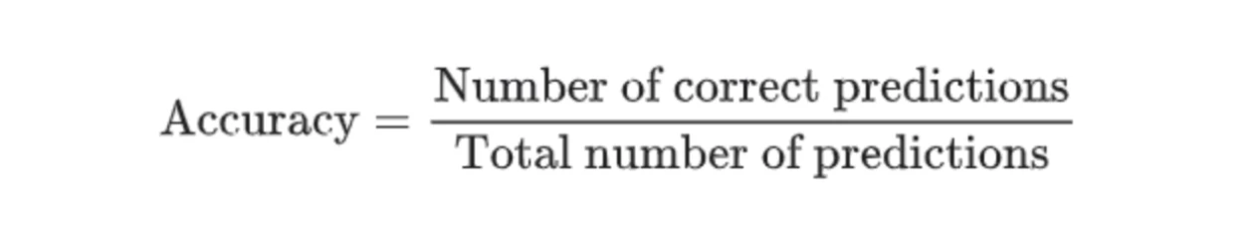
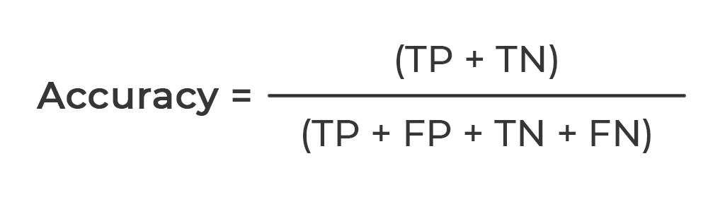
Methodology — Evaluation Metrics
Evaluation Metrics – Accuracy
Accuracy is a metric that measures how often a machine learning model correctly predicts the outcome of a given prediction task.
The Accuracy score is calculated by dividing the number of correct predictions by the total prediction number. It can also be calculated in in terms of positives and negatives.
A high Accuracy score indicates that the classifier is good at predicting which instances are positive. If a accuracy score 100%, then you have high and perfect accuracy model. Lower means it has problems predicting.

Slide 24
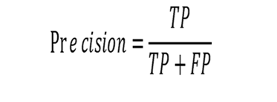
Methodology — Evaluation Metrics
Evaluation Metrics – Precision
Precision in machine learning is a metric used to evaluate the performance of a classifier. It is measured as how many of the positive predictions are actually correct.
Precision is calculated by dividing the total number of positive predictions or the number of true positives plus the number of false positives by the number of true positives.
A high precision score indicates that the classifier is good at predicting which instances are positive. A low precision score indicates that the classifier is predicting too many false positives.
Notes:
How many of the positive predictions are actually correct.

Slide 25
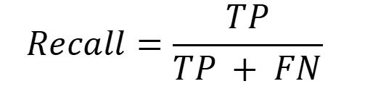
Methodology — Evaluation Metrics
Evaluation Metrics – Recall
Recall in machine learning is a metric used to evaluate the performance of a classifier. It is defined as the proportion of actual positives that are correctly identified by the classifier.
Recall is determined by dividing the total number of true positives by the sum of true positives and false negatives.
A high recall score indicates that the classifier is good at finding all the positive instances in the dataset. A low recall score indicates that the classifier is missing some of the positive instances.
Notes:
To find out the proportion of actual positives that were correctly identified

Slide 26
Methodology — Evaluation Metrics
Evaluation Metrics – F1 score
The F1 Score is a measure that combines recall and precision of a model.
Due to its ability to balance precision with recall, the F1 score is popular to utilize in binary and multiclass classification problems. Real life example: Healthcare, Fraud detection, and Spam classification.
If a model's Precision and Recall are both high, it will receive a high F1 score. If Precision and Recall are both poor, the F1 score for the model will be low. A model will have a medium F1 score if Precision and Recall are both high, but one is low.

Slide 27
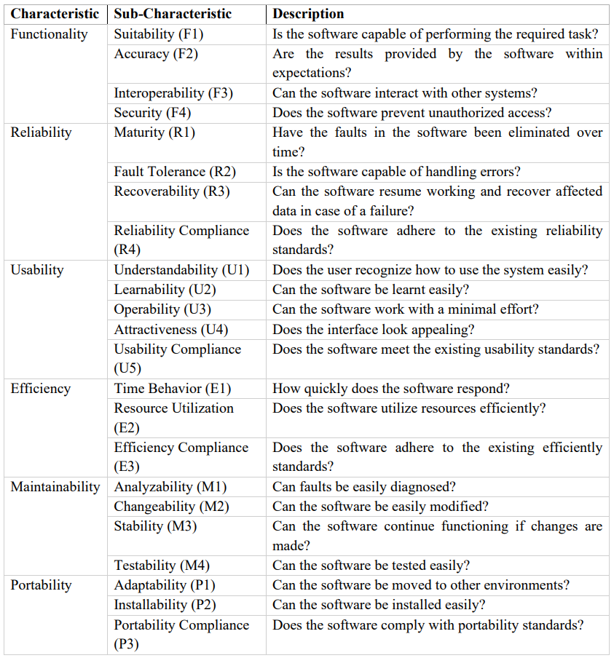
Methodology — Survey (ISO 9126)
ISO 9126 outlines a general framework of software quality evaluation as a more adaptable metric that can be used across a number of different systems (Chua & Dyson, 2004).
These metrics provide six (6) characteristics, each with a number of sub-characteristics as criteria, used to measure the external quality during the operation of the application (Wang et al., 2019)

Slide 28
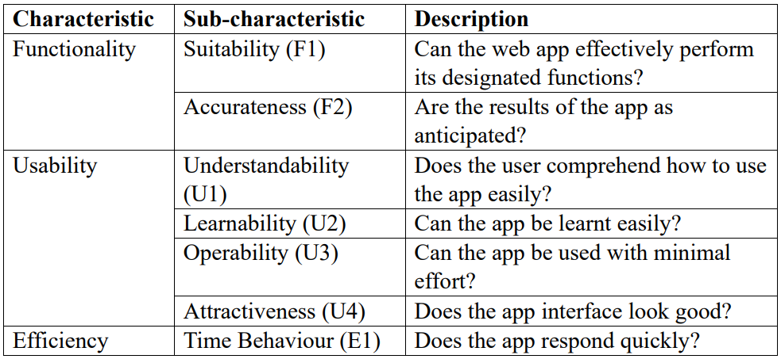
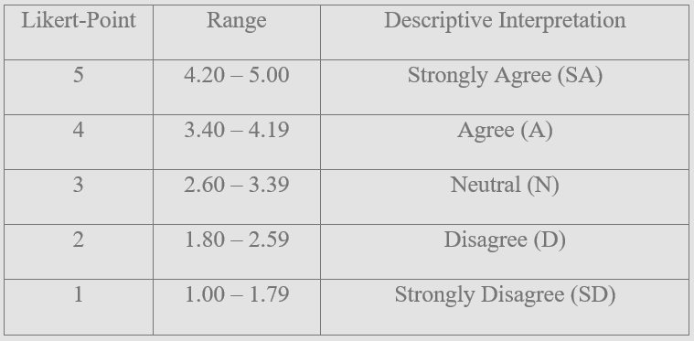
Methodology — Survey (Modified ISO 9126)
Several characteristics and sub-characteristics were omitted because these characteristics were either difficult to assess or not applicable.
5-point Likert rating scale was used to scale the respondent’s answers

Slide 29
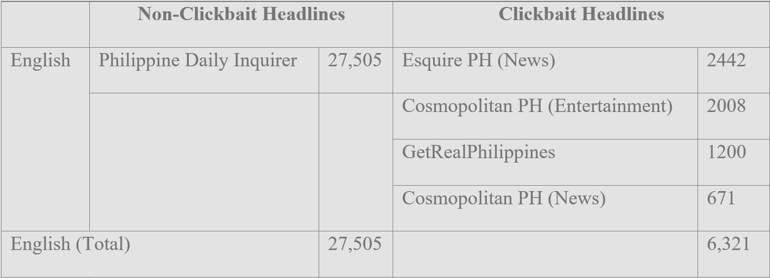
Results & Discussions — Dataset Collection

Slide 30
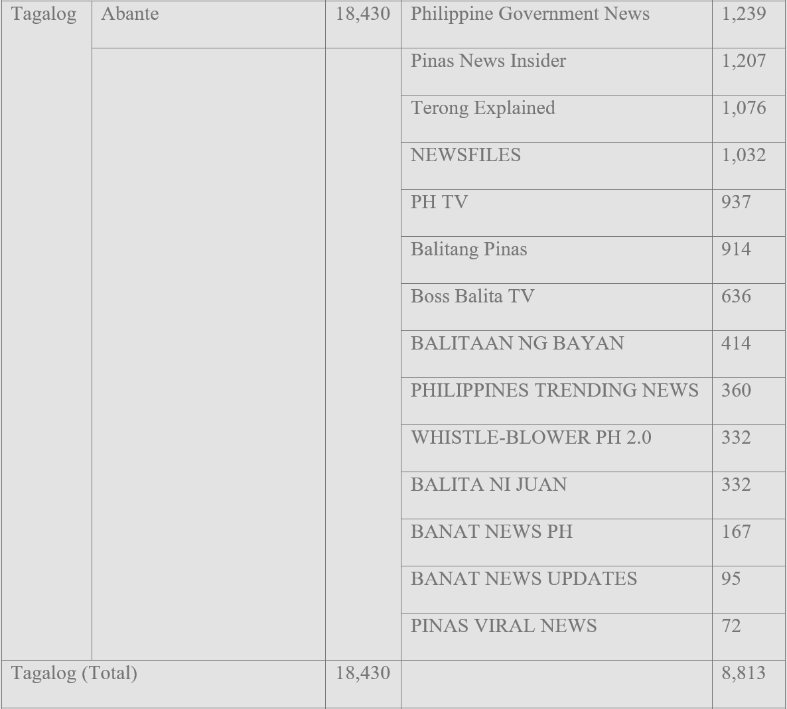
Results & Discussions — Dataset Collection
Notes:
Non-clickbait total: 45,935
Clickbait total: 15,134

Slide 31
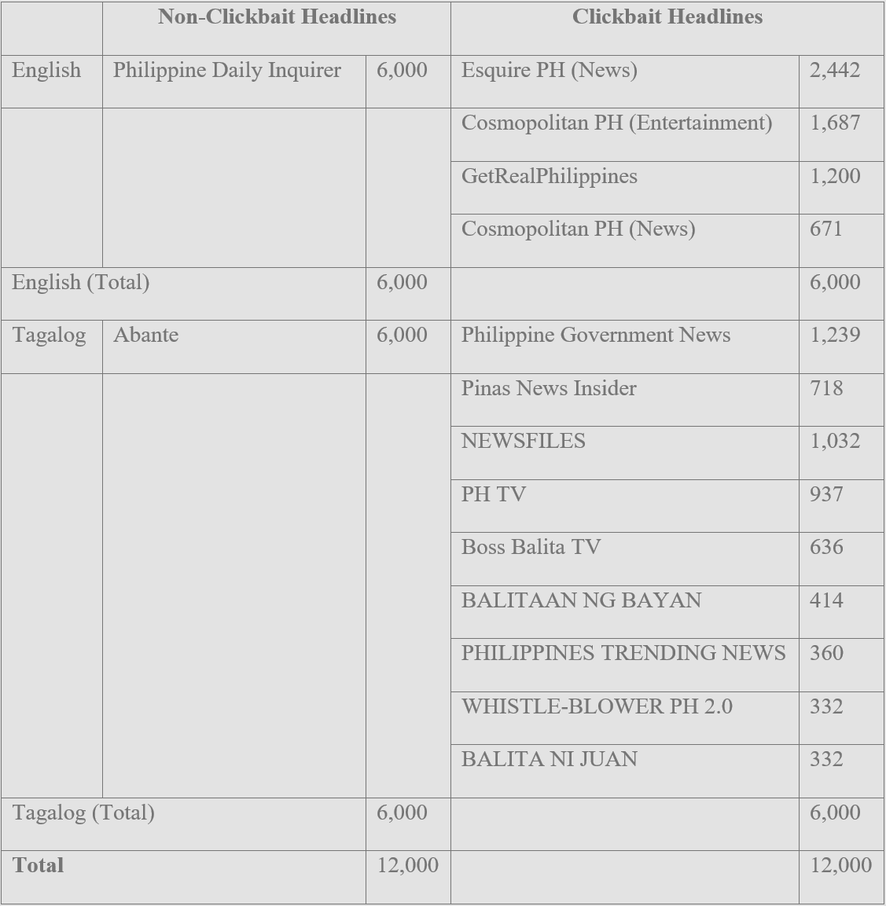
Results & Discussions — Dataset Collection

Slide 32
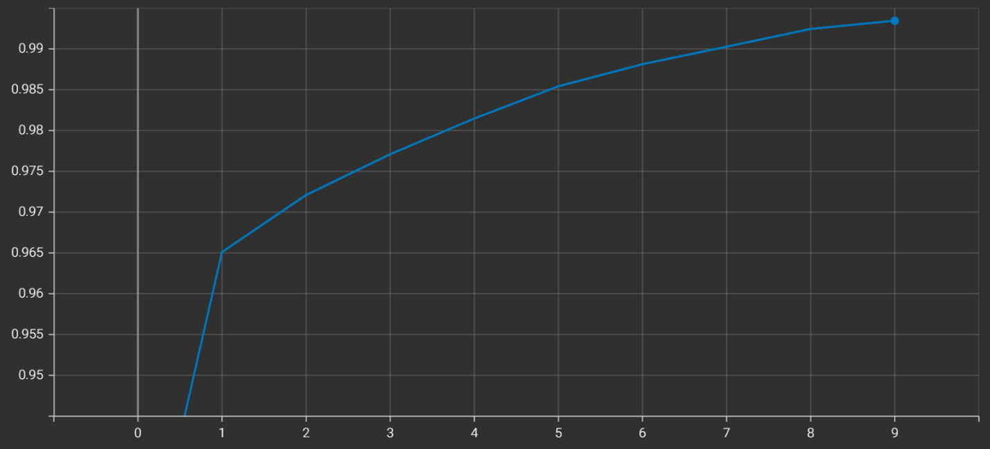
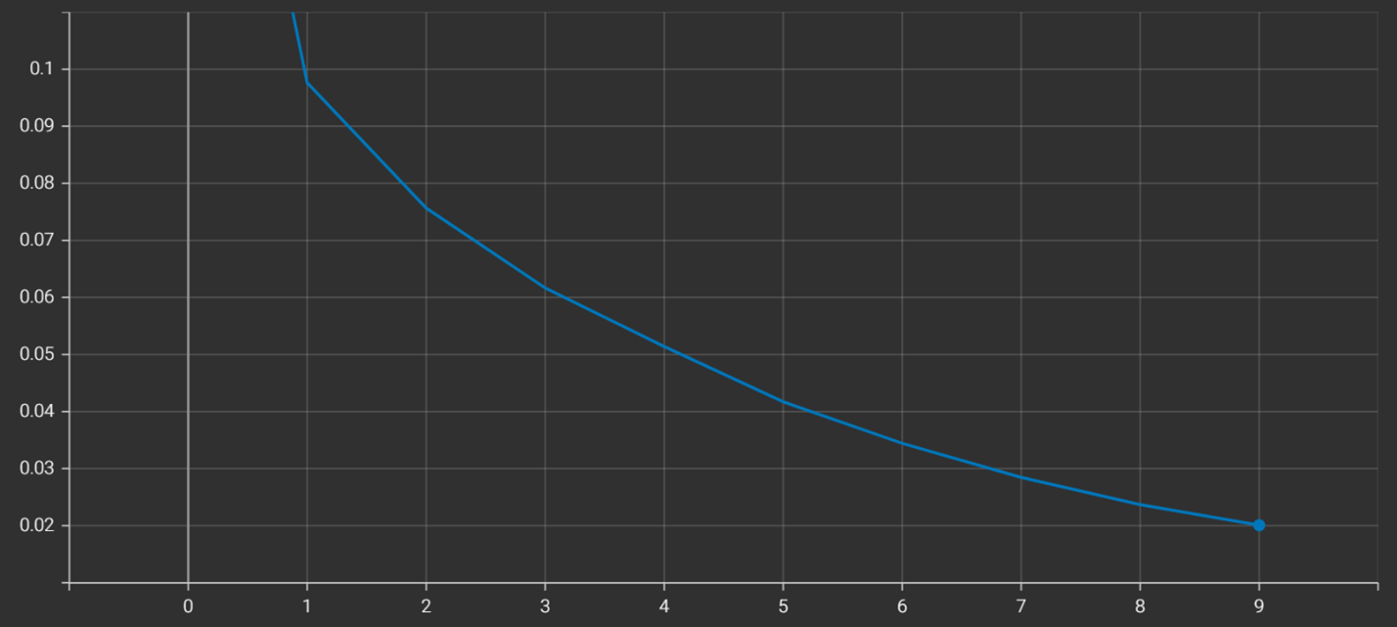
Results & Discussions — Training Results
Accuracy
Loss

Slide 33
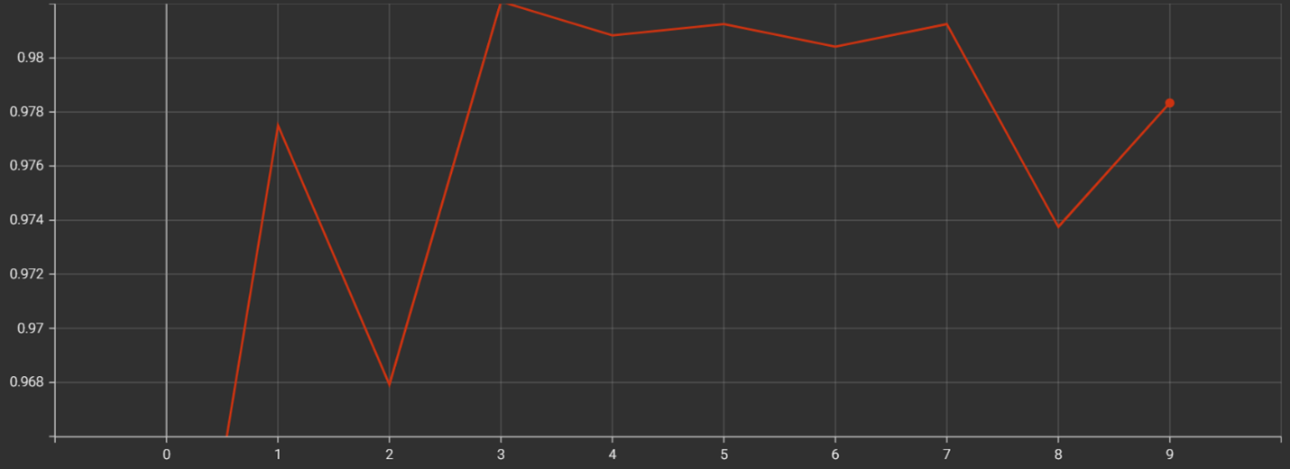
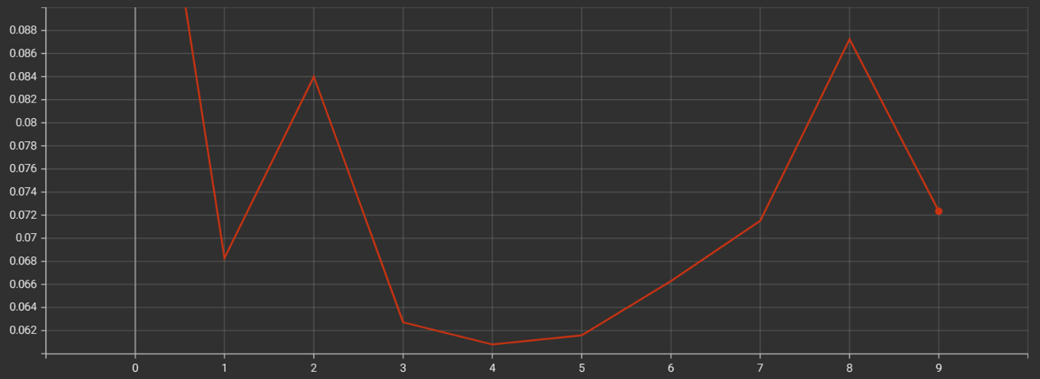
Results & Discussions — Validation Results
Accuracy
Loss

Slide 34
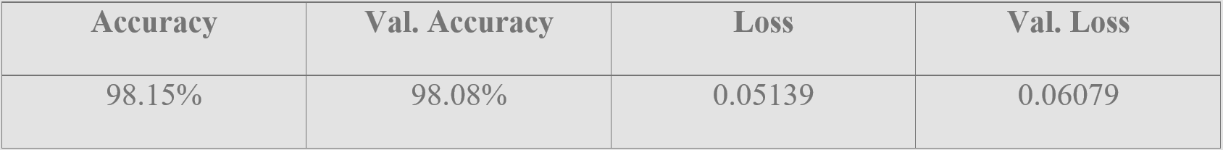
Results & Discussions — Training & Validation (Best)

Slide 35
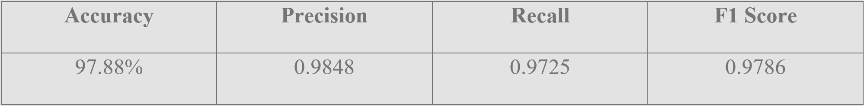
Results & Discussions — Test Results

Slide 36
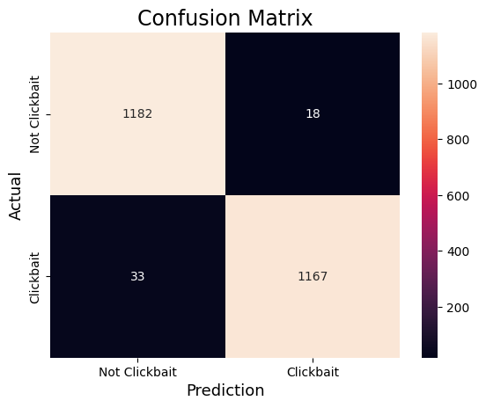
Results & Discussions — Test Results
Notes:
True Negative (Not Clickbait) – 1,182
False Positive (Predicted Clickbait but actually Not Clickbait) – 18
True Positive (Clickbait) – 1,167
False Negative (Predicted Not Clickbait but actually Clickbait) – 33

Slide 37
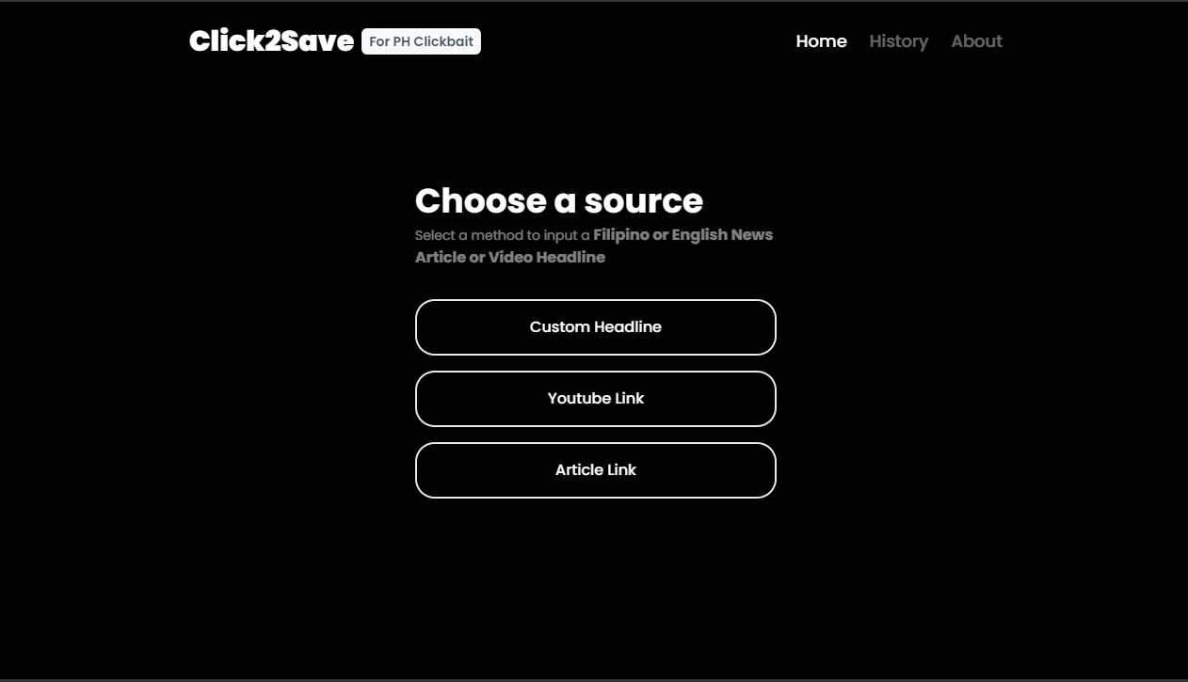
Results & Discussions — Web Application
Notes:
True Negative (Not Clickbait) – 1,182
False Positive (Predicted Clickbait but actually Not Clickbait) – 18
True Positive (Clickbait) – 1,167
False Negative (Predicted Not Clickbait but actually Clickbait) – 33

Slide 38

Results & Discussions — Web Application
Notes:
True Negative (Not Clickbait) – 1,182
False Positive (Predicted Clickbait but actually Not Clickbait) – 18
True Positive (Clickbait) – 1,167
False Negative (Predicted Not Clickbait but actually Clickbait) – 33

Slide 39
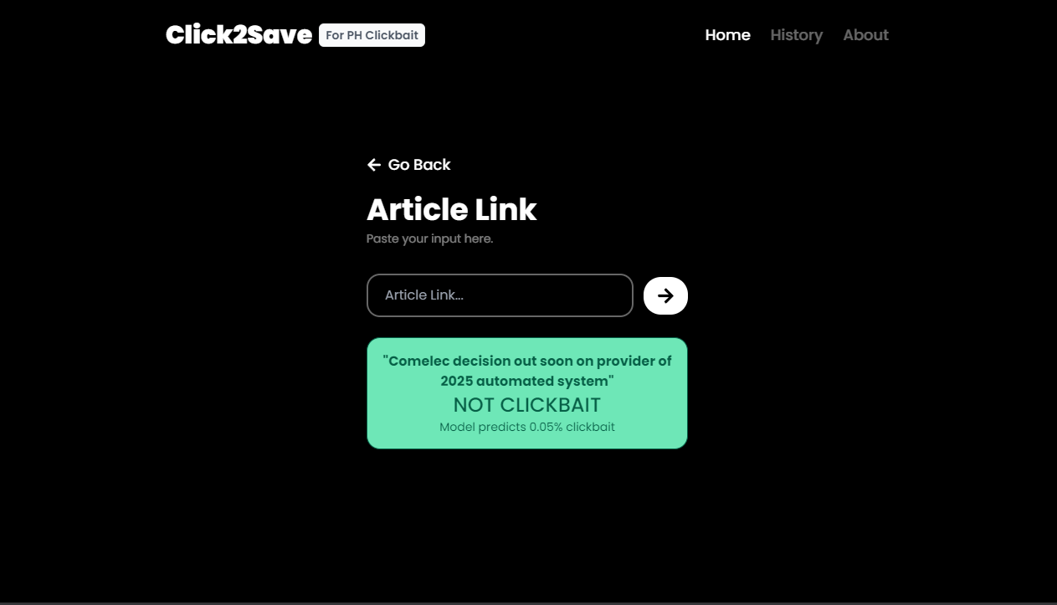
Results & Discussions — Web Application
Notes:
True Negative (Not Clickbait) – 1,182
False Positive (Predicted Clickbait but actually Not Clickbait) – 18
True Positive (Clickbait) – 1,167
False Negative (Predicted Not Clickbait but actually Clickbait) – 33

Slide 40
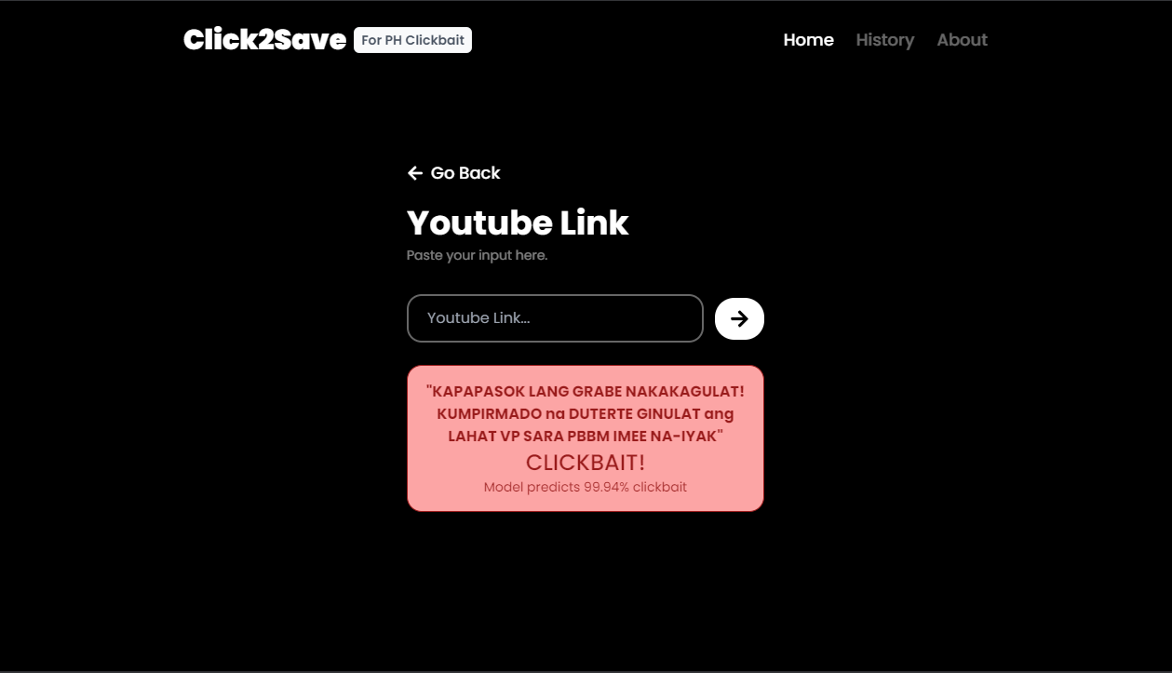
Results & Discussions — Web Application
Notes:
True Negative (Not Clickbait) – 1,182
False Positive (Predicted Clickbait but actually Not Clickbait) – 18
True Positive (Clickbait) – 1,167
False Negative (Predicted Not Clickbait but actually Clickbait) – 33

Slide 41
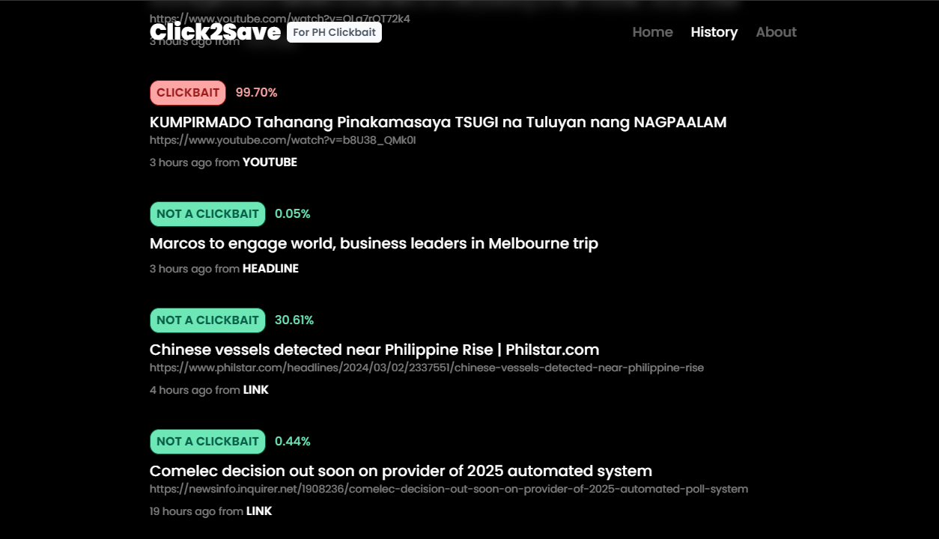
Results & Discussions — Web Application
Notes:
True Negative (Not Clickbait) – 1,182
False Positive (Predicted Clickbait but actually Not Clickbait) – 18
True Positive (Clickbait) – 1,167
False Negative (Predicted Not Clickbait but actually Clickbait) – 33

Slide 42
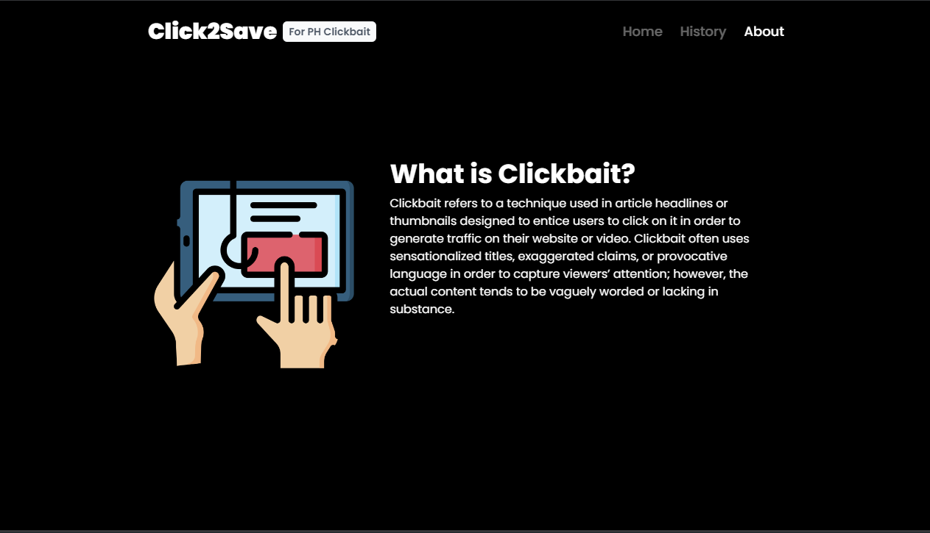
Results & Discussions — Web Application
Notes:
True Negative (Not Clickbait) – 1,182
False Positive (Predicted Clickbait but actually Not Clickbait) – 18
True Positive (Clickbait) – 1,167
False Negative (Predicted Not Clickbait but actually Clickbait) – 33

Slide 43
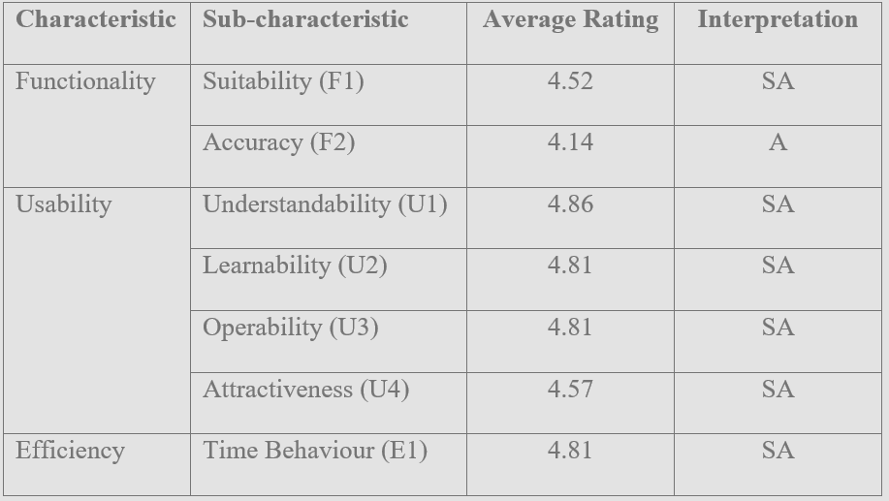
Results & Discussions — Survey Results
Notes:
- Overall, web app was met with positive responses.
- Web app could effectively perform its function.
- Design was well received
- Web app responded quickly
- Easy to learn and understand how to use the app.
- Easy to use the app
- Accuracy had some issues.

Slide 44

Conclusions
Evaluate Model
Evaluate the performance of the clickbait detection model.
Generate Dataset
Collect clickbait and non-clickbait Filipino News Headlines (both in Filipino and English).
Train Model
Develop a clickbait detection system using a pre-trained MobileBERT language model with a BiGRU model.

Slide 45
Conclusions (cont.)
Develop a Web Application
Develop a web application to interact with the clickbait detection model.

Slide 46

Recommendations
Larger Dataset
Collect more samples for more data to train with.
Other BERT Models
Tagalog-BERT, RoBERTa Tagalog, training a English-Tagalog BERT, or other Transformer models.
Fine-tune BERT
Fine-tune BERT models instead of using BiGRU.

Slide 47

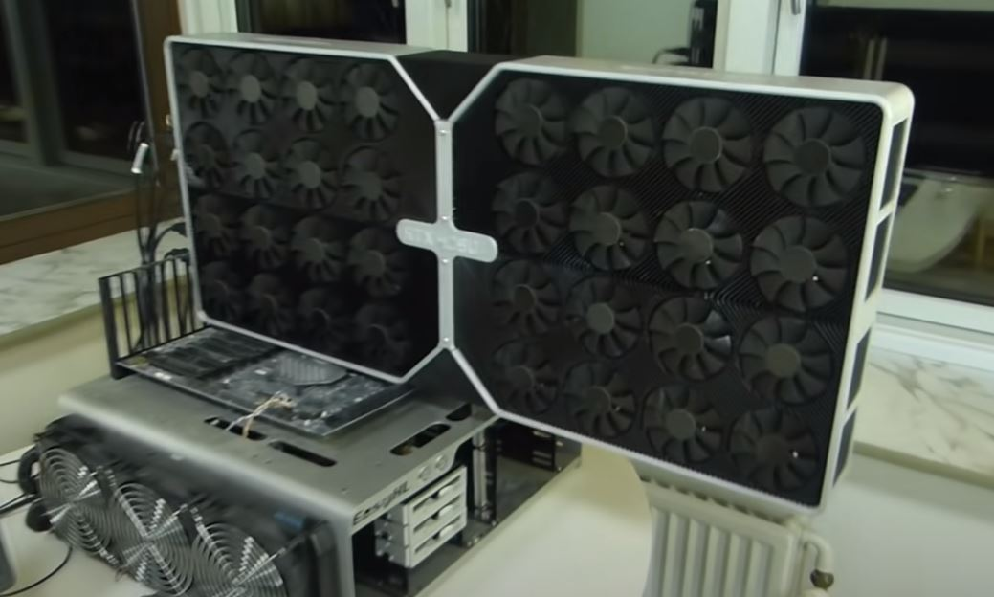

Recommendations (cont.)
Better Hardware
Better hardware to accommodate larger datasets, more expensive algorithms, and for faster training.

Slide 48
Group Members:
Ang, Matthew Szenel S.
Abid, James Paul N.
Tan, Andre Deuce B.
BS in Computer Science
Adviser:
Jeanie R. Delos Arcos
Thank you

